Slide 1
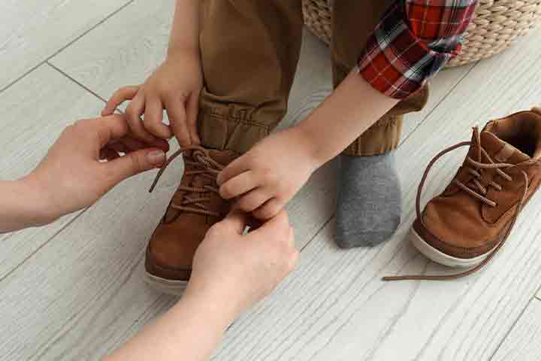


Mental Health
&
Wellbeing
Aim: Is for children to feel happy, comfortable, healthy & confident individuals.
Five ways to wellbeing:
Keep active
Take notice
Connect.
Keep learning.
Keep Giving
It’s never too early or too late to work towards being the healthiest you.
Spring Bank Primary School Wellbeing Champion
Rebecca Bowles
Mentaml Health
&
wellbeing
M

Slide 2


Who can I tell when I need a helping hand​
Tell a friend,
A member of the school council,
A teacher or a teaching assistant,
Headteacher
Miss Ditta
Mrs Bonner, or Amy Yonng
School club staff
Parents & carers
Rebecca Bowles PCSO
Spring Bank Primary let’s get talking.
It is very important to talk to others about your feelings & when you need help. So that you can feel safe, healthy & happy.

